Slide 1


http://www.comp.nus.edu.sg/~cs2100/
Lecture #3b
Data Representation and Number Systems

Slide 2
Questions?
Ask at https://sets.netlify.app/module/66988ae3322ba68d1103fdd4
OR
Scan and ask your questions here! (May be obscured in some slides)

Slide 3
9. ASCII Code (1/3)
ASCII code and Unicode are used to represent characters (‘a’, ‘C’, ‘?’, ‘\0’, etc.)
ASCII
American Standard Code for Information Interchange
7 bits, plus 1 parity bit (odd or even parity)

Slide 4
9. ASCII Code (2/3)
‘A’: 1000001 (or 65₁₀)
ASCII table

Slide 5
9. ASCII Code (3/3)
(Slide 5 in lecture 3a)
As an ‘int’, it is 70
01000110
As a ‘char’, it is ‘F’
Integers (0 to 127) and characters are ‘somewhat’ interchangeable in C
CharAndInt.c
int num = 65;
char ch = 'F';
printf("num (in %%d) = %d\n", num);
printf("num (in %%c) = %c\n", num);
printf("\n");
printf("ch (in %%c) = %c\n", ch);
printf("ch (in %%d) = %d\n", ch);
num (in %d) = 65
num (in %c) = A
ch (in %c) = F
ch (in %d) = 70


Slide 6
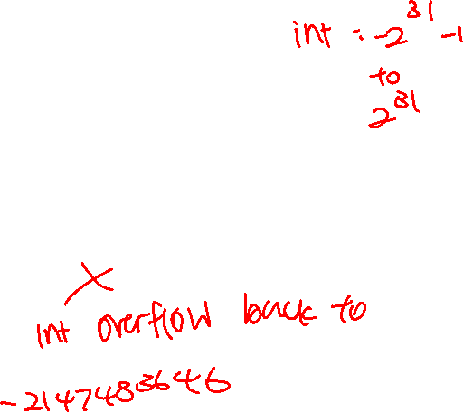
Past-Year’s Exam Question!
PastYearQn.c
int i, n = 2147483640;
for (i=1; i<=10; i++) {
n = n + 1;
}
printf("n = %d\n", n);
What is the output of the above code when run on sunfire?
Is it 2147483650?

Slide 7
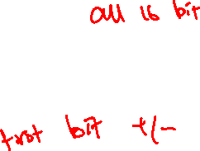
10. Negative Numbers
Unsigned numbers: only non-negative values
Signed numbers: include all values (positive and negative)
There are 3 common representations for signed binary numbers:
Sign-and-Magnitude
1s Complement
2s Complement

Slide 8
10.1 Sign-and-Magnitude (1/3)
The sign is represented by a ‘sign bit’
0 for +
1 for -
Eg: a 1-bit sign and 7-bit magnitude format.
sign
magnitude
00110100 ➔ +110100₂ = +52₁₀
10010011 ➔ -10011₂ = -19₁₀

Slide 9
10.1 Sign-and-Magnitude (2/3)
Largest value: 01111111 = +127₁₀
Smallest value: 11111111 = -127₁₀
Zeros: 00000000 = +0₁₀ 10000000 = -0₁₀
Range (for 8-bit): -127₁₀ to +127₁₀
Question:
For an n-bit sign-and-magnitude representation, what is the range of values that can be represented?

Slide 10

10.1 Sign-and-Magnitude (3/3)
To negate a number, just invert the sign bit.
Examples:
How to negate 00100001_{sm} (decimal 33)? Answer: 10100001_{sm} (decimal -33)
How to negate 10000101_{sm} (decimal -5)? Answer: 00000101_{sm} (decimal +5)

Slide 11
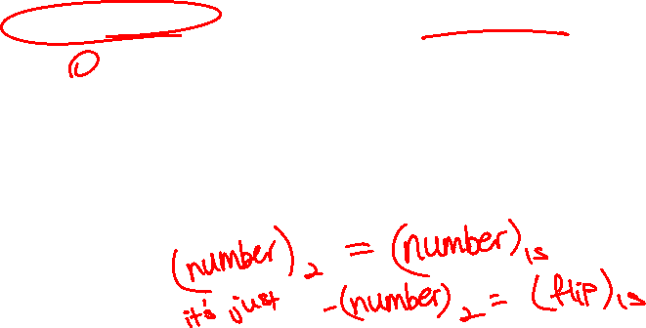
10.2 1s Complement (1/3)
Given a number x which can be expressed as an n-bit binary number, its negated value can be obtained in 1s-complement representation using:
-x = 2^{n} – x – 1
Example: With an 8-bit number 00001100 (or 12₁₀), its negated value expressed in 1s-complement is:
-00001100₂ = 2⁸ – 12 – 1 (calculation done in decimal) = 243 = 11110011_{1s}
(This means that -12₁₀ is written as 11110011 in 1s-complement representation.)

Slide 12
10.2 1s Complement (2/3)
Technique to negate a value: invert all the bits.
Largest value: 01111111 = +127₁₀
Smallest value: 10000000 = -127₁₀
Zeros: 00000000 = +0₁₀ 11111111 = -0₁₀
Range (for 8 bits): -127₁₀ to +127₁₀
Range (for n bits): -(2^{n-1} – 1) to 2^{n-1} – 1
The most significant bit (MSB) still represents the sign: 0 for positive, 1 for negative.

Slide 13
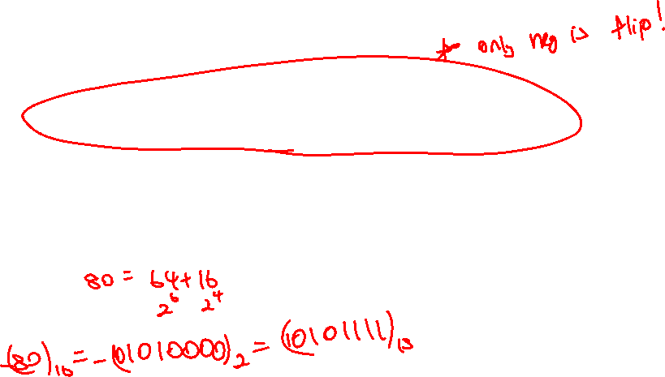
10.2 1s Complement (3/3)
Examples (assuming 8-bit):
(14)₁₀ = (00001110)₂ = (00001110)_{1s}
-(14)₁₀ = -(00001110)₂ = (11110001)_{1s}
-(80)₁₀ = -( ? )₂ = ( ? )_{1s}

Slide 14
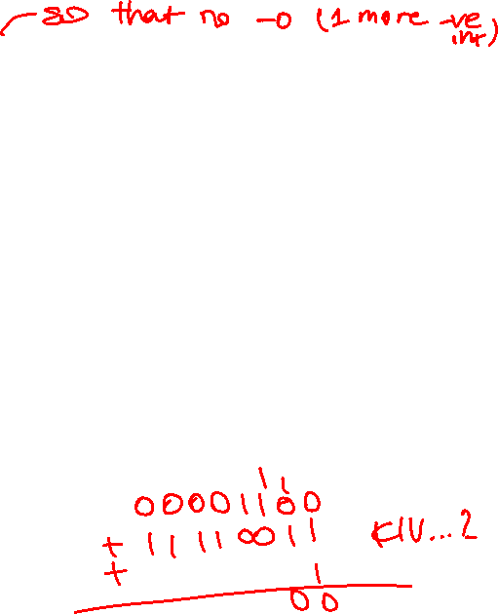
10.3 2s Complement (1/3)
Given a number x which can be expressed as an n-bit binary number, its negated value can be obtained in 2s-complement representation using:
-x = 2^{n} – x
Example: With an 8-bit number 00001100 (or 12₁₀), its negated value expressed in 2s-complement is:
-00001100₂ = 2⁸ – 12 (calculation done in decimal) = 244 = 11110100_{2s}
(This means that -12₁₀ is written as 11110100 in 2s-complement representation.)

Slide 15
10.3 2s Complement (2/3)
Technique to negate a value: invert all the bits, then add 1.
Largest value: 01111111 = +127₁₀
Smallest value: 10000000 = -128₁₀
Zero: 00000000 = +0₁₀
Range (for 8 bits): -128₁₀ to +127₁₀
Range (for n bits): -2^{n-1} to 2^{n-1} – 1
The most significant bit (MSB) still represents the sign: 0 for positive, 1 for negative.

Slide 16
10.3 2s Complement (3/3)
Examples (assuming 8-bit):
(14)₁₀ = (00001110)₂ = (00001110)_{2s}
-(14)₁₀ = -(00001110)₂ = (11110010)_{2s}
-(80)₁₀ = -( ? )₂ = ( ? )_{2s}
Compare with slide 13.
1s complement:
(14)₁₀ = (00001110)₂ = (00001110)_{1s}
-(14)₁₀ = -(00001110)₂ = (11110001)_{1s}

Slide 17
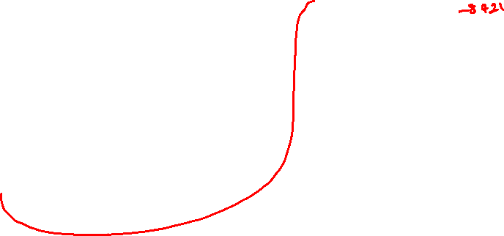
Important!
10.4 Comparisons
4-bit system
Positive values Negative values
Value | Sign-and-Magnitude | 1s Comp. | 2s Comp.
+7 | 0111 | 0111 | 0111
+6 | 0110 | 0110 | 0110
+5 | 0101 | 0101 | 0101
+4 | 0100 | 0100 | 0100
+3 | 0011 | 0011 | 0011
+2 | 0010 | 0010 | 0010
+1 | 0001 | 0001 | 0001
+0 | 0000 | 0000 | 0000
Value | Sign-and-Magnitude | 1s Comp. | 2s Comp.
-0 | 1000 | 1111 | -
-1 | 1001 | 1110 | 1111
-2 | 1010 | 1101 | 1110
-3 | 1011 | 1100 | 1101
-4 | 1100 | 1011 | 1100
-5 | 1101 | 1010 | 1011
-6 | 1110 | 1001 | 1010
-7 | 1111 | 1000 | 1001
-8 | - | - | 1000

Slide 18
Past-Year’s Exam Question! (Answer)
PastYearQn.c
int i, n = 2147483640;
for (i=1; i<=10; i++) {
n = n + 1;
}
printf("n = %d\n", n);
What is the output of the above code when run on sunfire?
Is it 2147483650?
✗
1st iteration: n = 2147483641
7th iteration: n = 2147483647
int type in sunfire takes up 4 bytes (32 bits) and uses 2s complement
Largest positive integer = 2³¹ – 1 = 2147483647
01111 ……. 1111111111
+ 1
10000…….0000000000
8th iteration: n = -2147483648
9th iteration: n = -2147483647
10th iteration: n = -2147483646


Slide 19
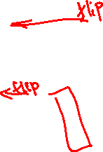
10.5 Complement on Fractions
We can extend the idea of complement on fractions.
Examples:
Negate 0101.01 in 1s-complement Answer: 1010.10
Negate 111000.101 in 1s-complement Answer: 000111.010
Negate 0101.01 in 2s-complement Answer: 1010.11

Slide 20
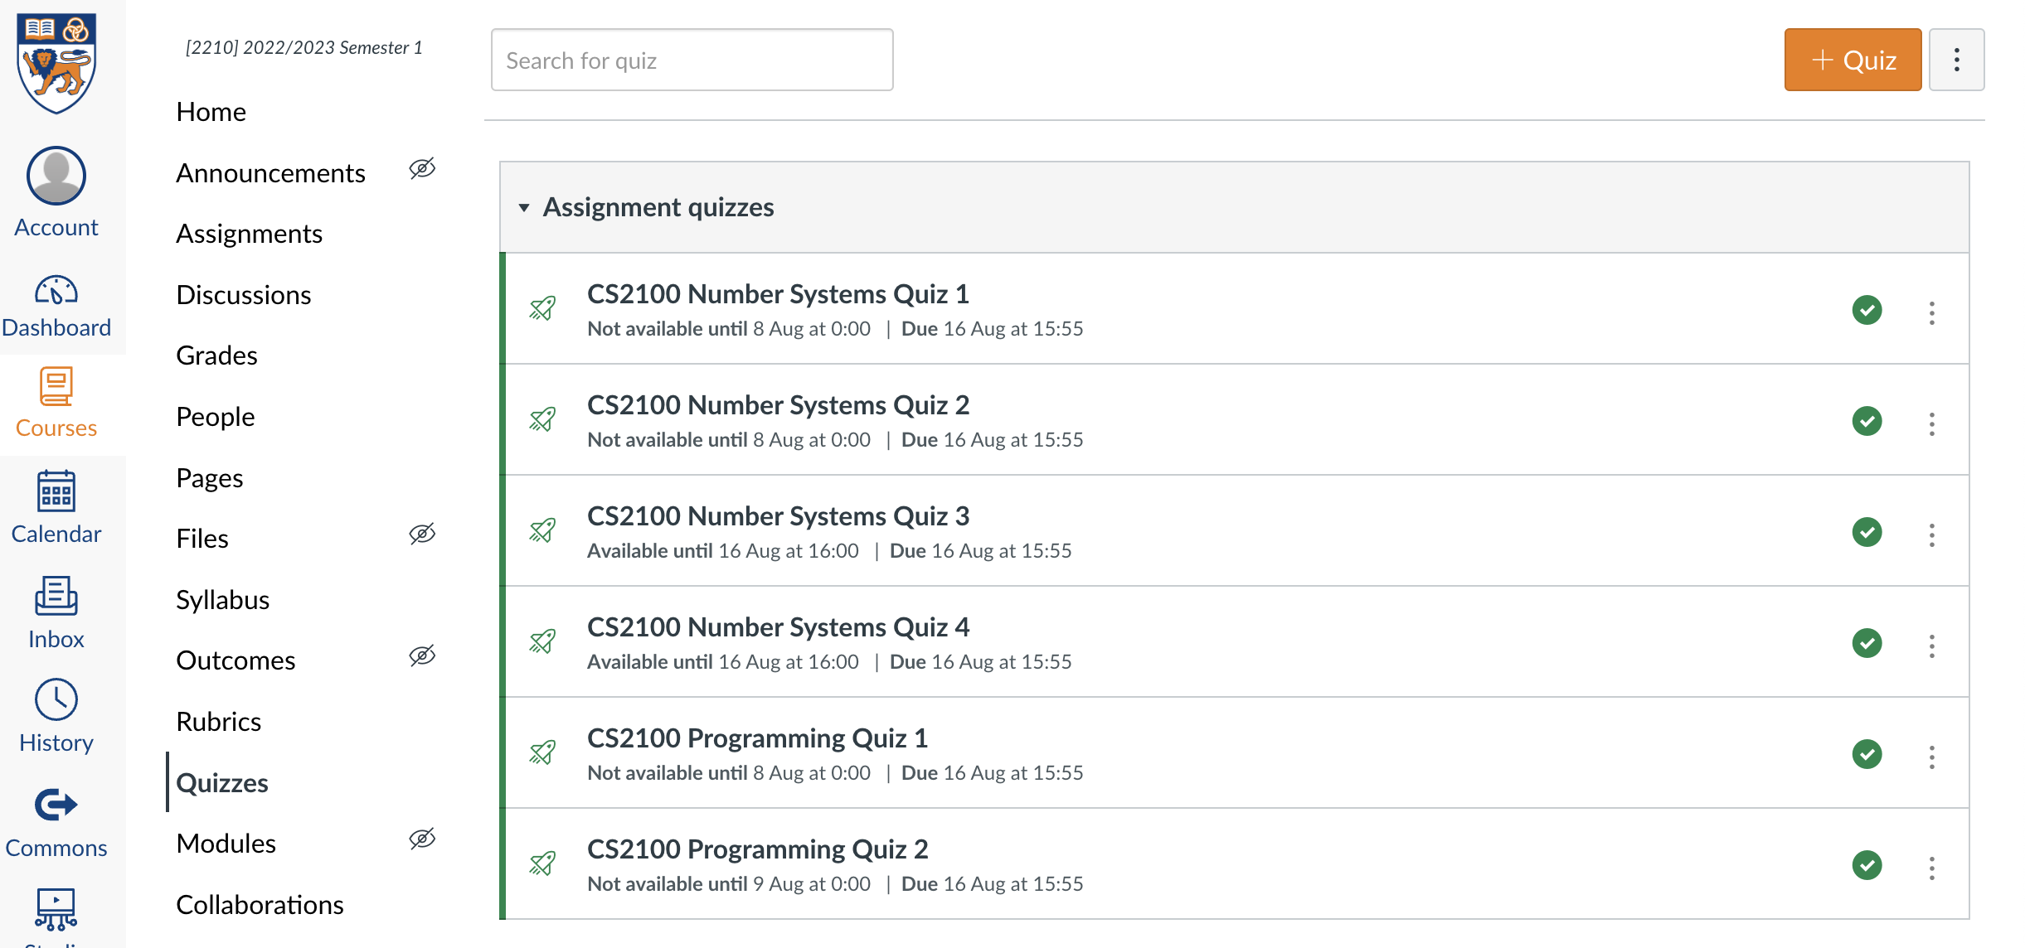
Quiz
Please complete the “CS2100 C Number Systems Quiz 2” in Canvas.
Access via the “Quizzes” tool in the left toolbar and select the quiz on the right side of the screen.

Slide 21
End of File

